Slide 1

By Omkar Barge
Data Science with Python Career Program - Capstone Project

Slide 2

Agenda
Data Exploration
Data insights
EDA Graphs.
Graphical Analysis and conclusion on Data
Data Cleaning & Pre-Processing Steps.
ML Modeling
Deployment of ML Models using Streamlit.

Slide 3
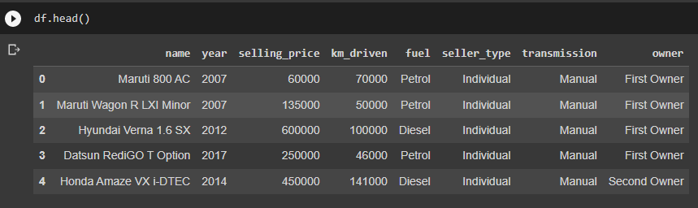
Data Exploration
Dataset contains information of used cars.
Information present in dataset is Name of company, Manufactured Year, Selling Price,
Km driven, Fuel, Seller Type, Transmission, Owner.

Slide 4
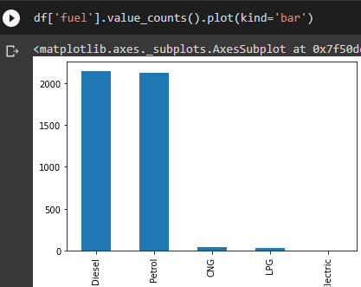
Data insights
Dataset having more records of Diesel and Petrol.
Considering fuel columns we can say dataset is imbalanced.

Slide 5
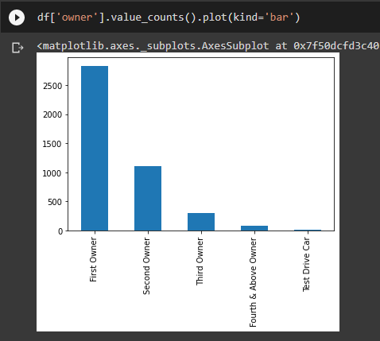
Data insights
Like fuel column owner column also have more records of First Owner

Slide 6
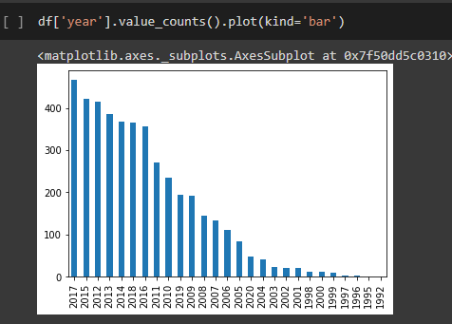
Data insights
Year model distribution.

Slide 7
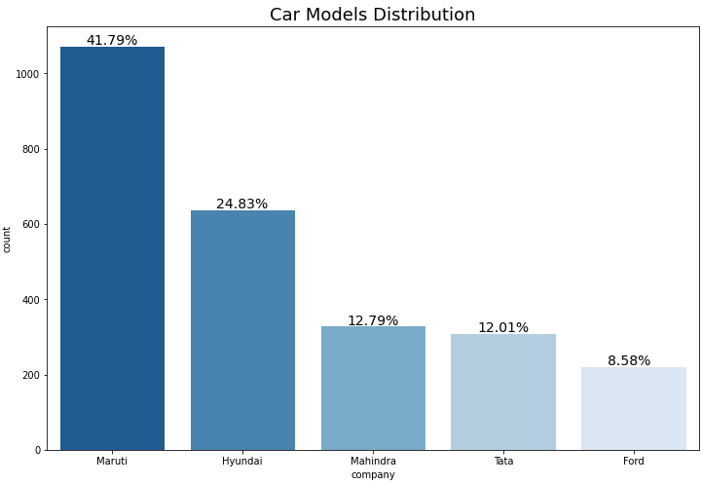
Data insights

Slide 8
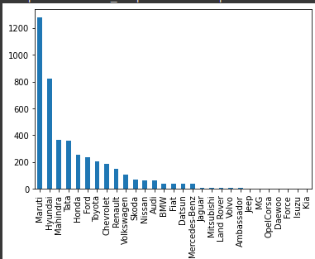
Data insights
Car model distribution.

Slide 9
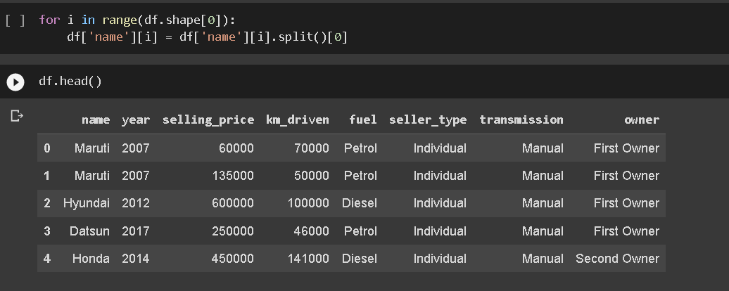
Data Cleaning & Pre-Processing Steps.
Extracted Manufacturer name from ‘name’ columns

Slide 10
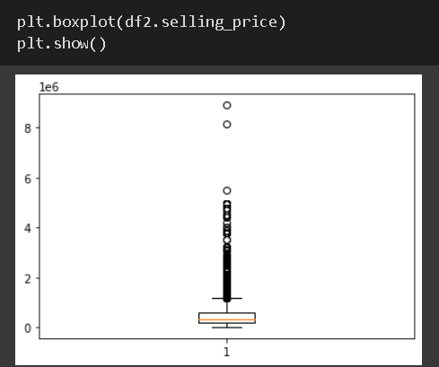
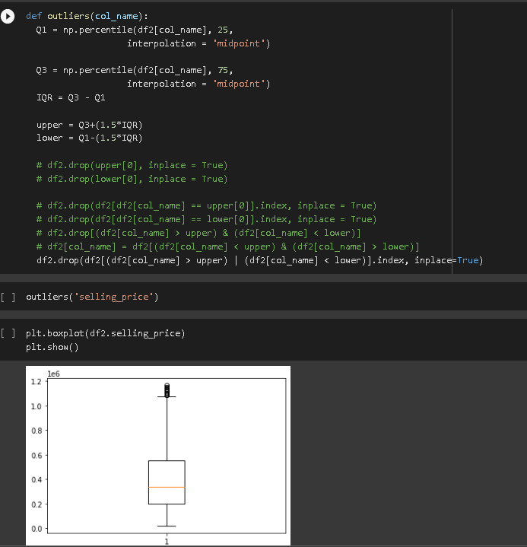
Data Cleaning & Pre-Processing Steps.
Outliers present in selling_price column
Treated Outliers

Slide 11
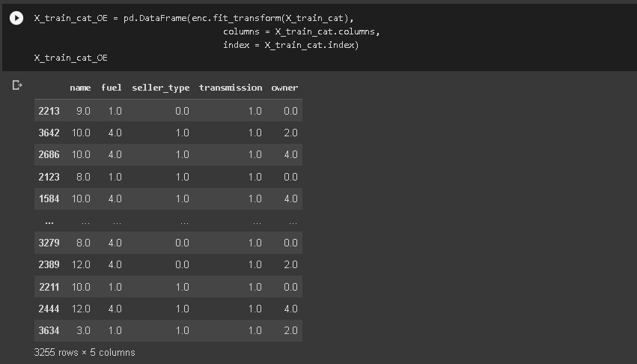
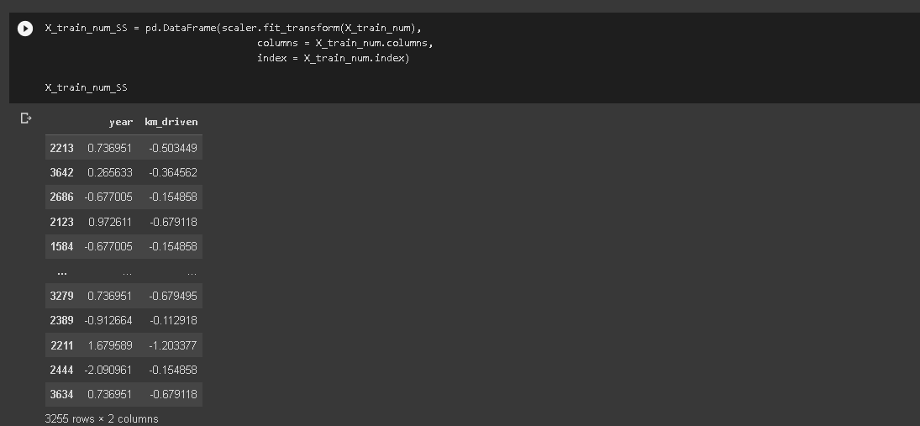
Data Cleaning & Pre-Processing Steps.
Firstly Splited data into train test,
After applied Ordinal encoding to categorical columns and Standard scalar to train and test data after
spliting,
I had done scaling after the splitting process because if we do scaling before splitting, their can be
changes of data lickeage and it can be affect over model.

Slide 12
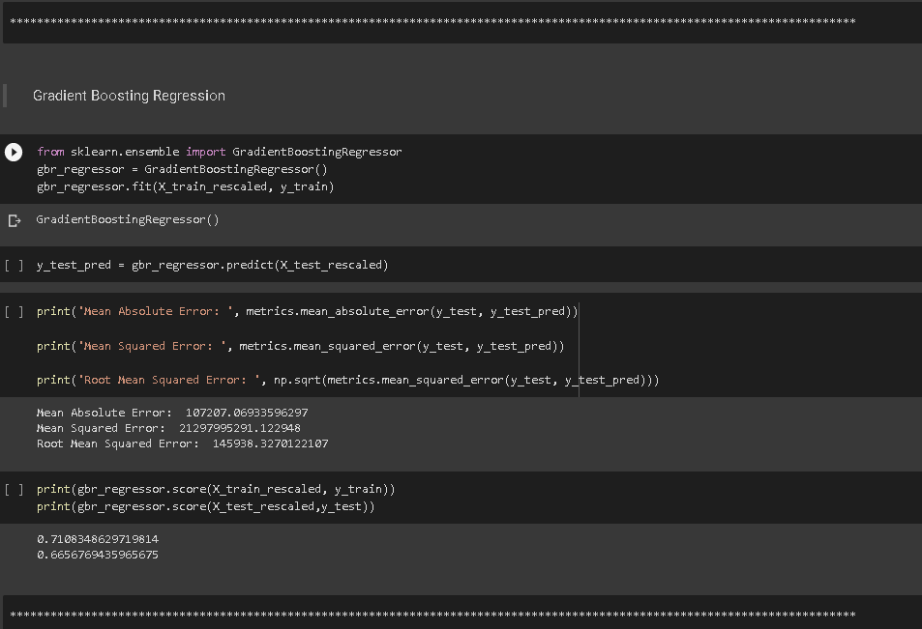
ML Modeling
I had trained various model like Random Forest,
Decision Tree, Gradient Boosting, SVM, KNN
Linear Regression, Lasso, Ridge.
Gradient Boosting is giving great accuracy on
this dataset comparing other models, other
Models are overfitting because I choose
Gradient boosting model for this project based
On train and test score.

Slide 13
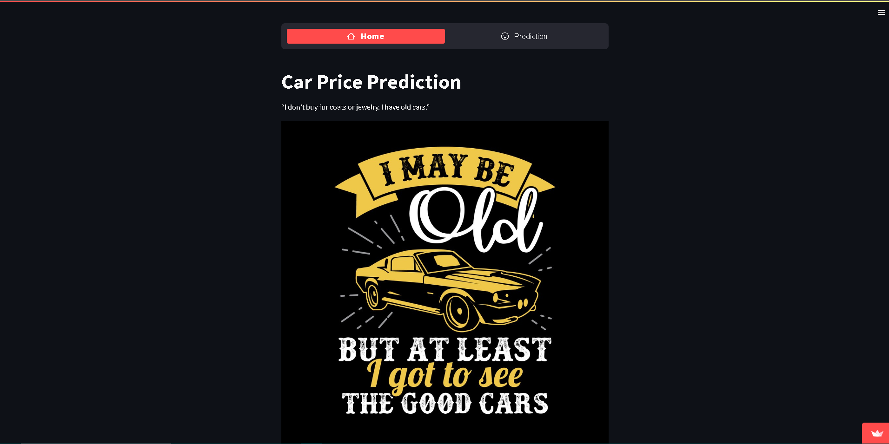
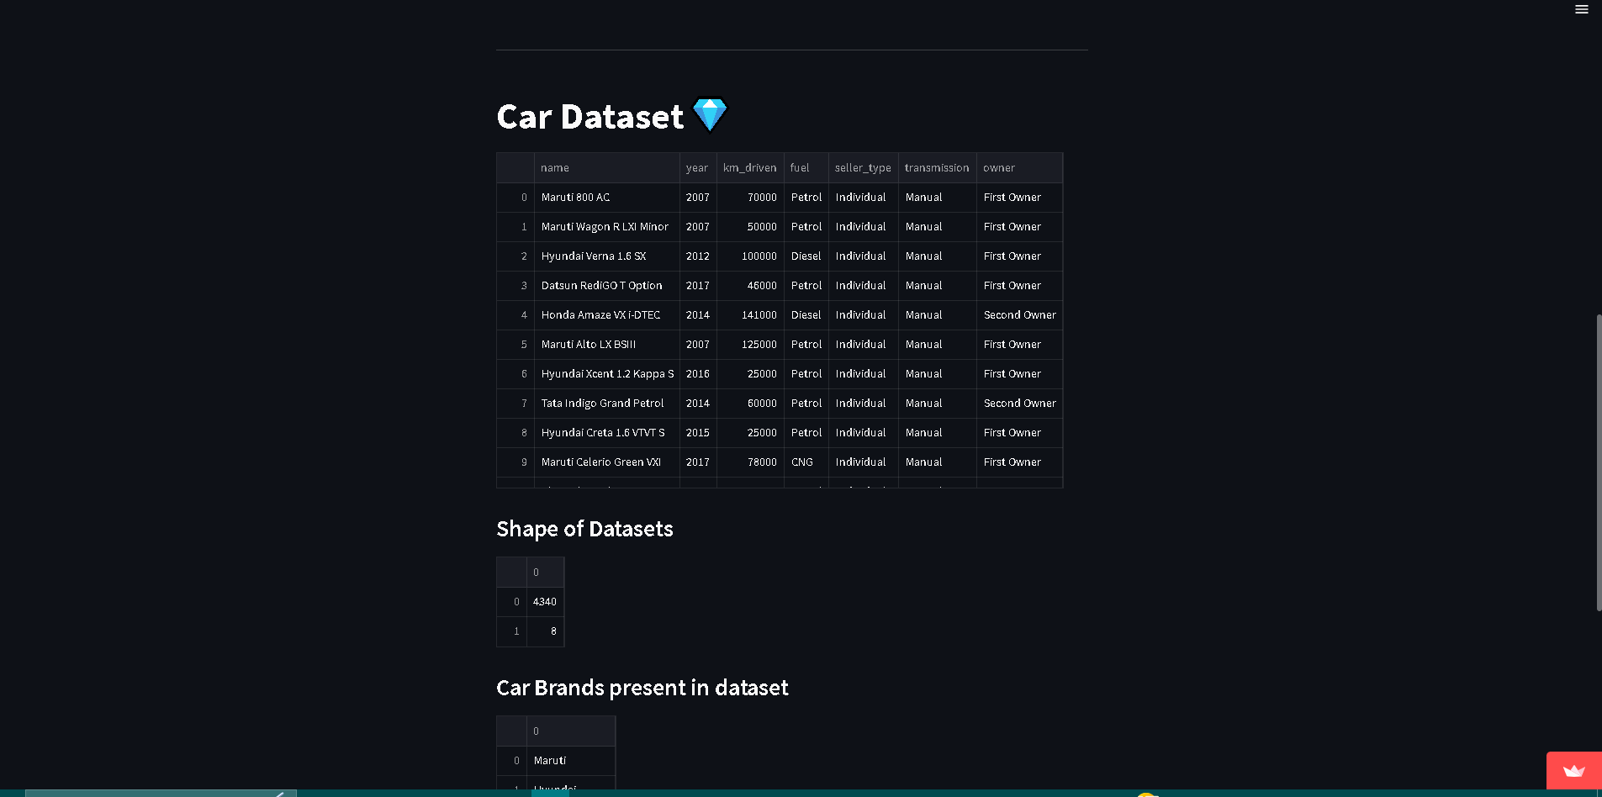
Deployment of ML Models using Streamlit.
Created web app for prediction using streamlit
and deployed on same streamlit cloud platform
This is first page of webapp containing basic
Information of dataset.

Slide 14
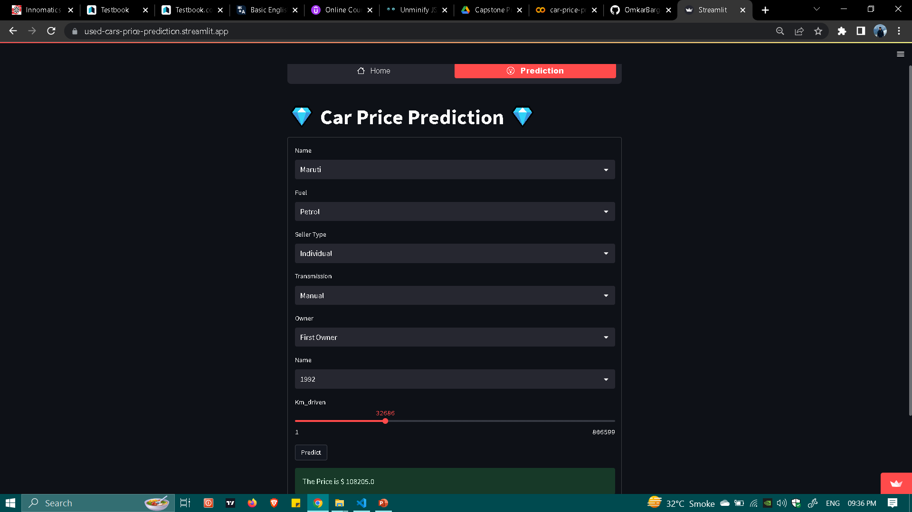
Deployment of ML Models using Streamlit.
This is main page of our web app which is use for predictions.

Slide 15
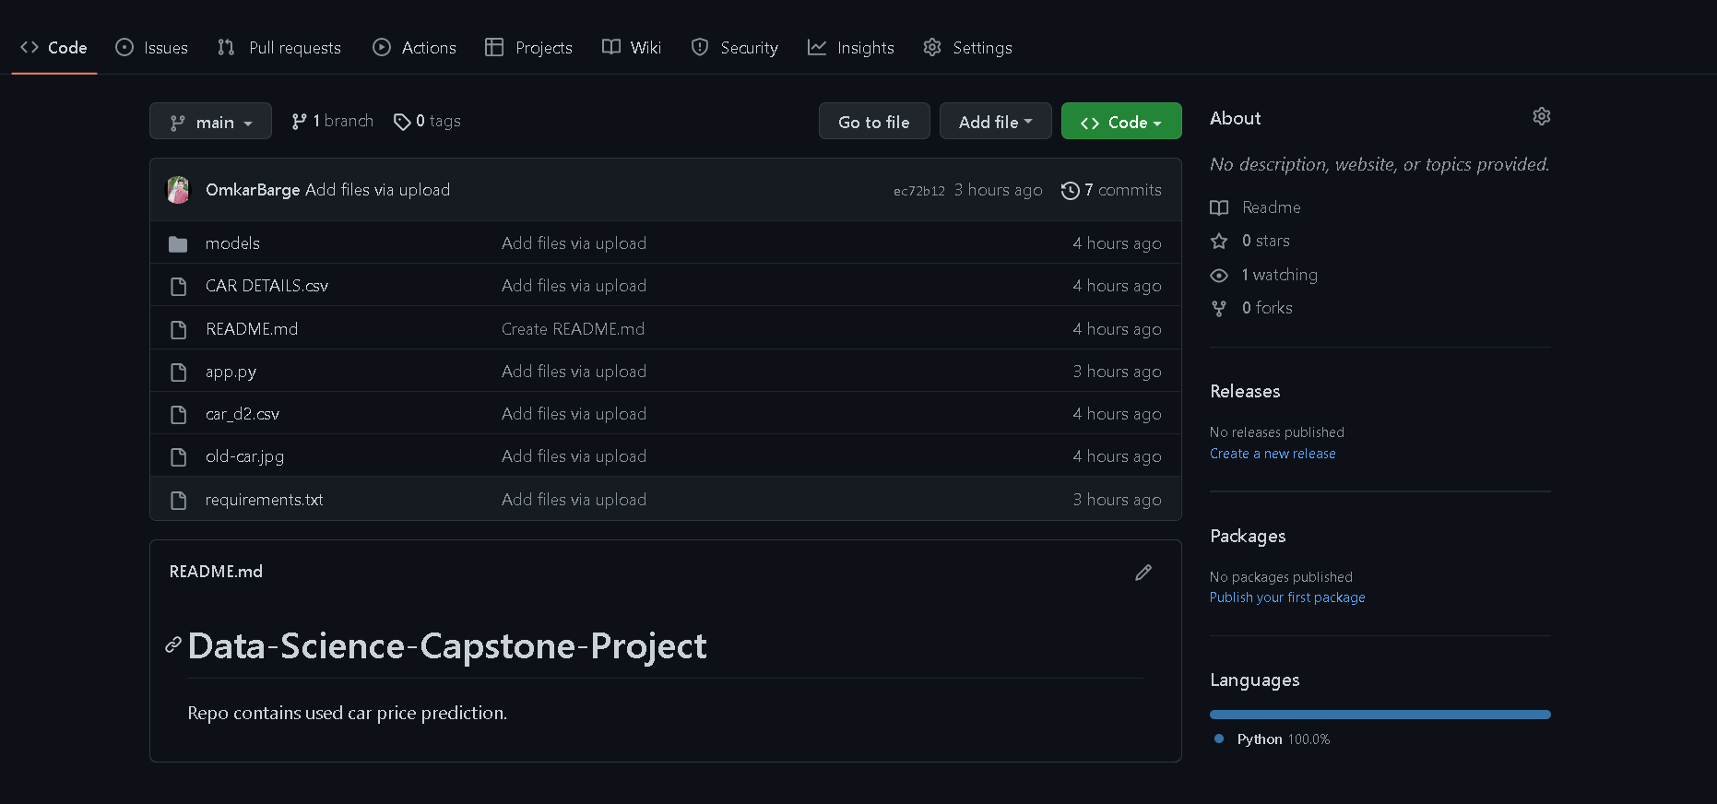
Github
Uploaded all files regarding this project to github along with best model.
link : - https://github.com/OmkarBarge/Data-Science-Capstone-Project

Slide 16
Endnotes
Reference Links:-
Githib link: https://github.com/OmkarBarge/Data-Science-Capstone-Project
Streamlit: https://used-cars-price-prediction.streamlit.app/

Slide 17
Endnotes
Thank You
Omkar S Barge

